Slide 1

Ironhack Data Analytics Bootcamp
Tanya Zanina
Akshay Panchal
Clara Balcells

Slide 2

Do you recognise yourself in this picture?

Slide 3

Maybe in this one?

Slide 4

Or this one?

Slide 5
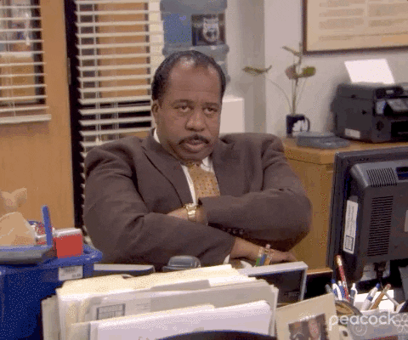
Are you bored of being bored?

Slide 6
How to improve this situation?

Slide 7
We all have at least 15 mins each day of spare time.
What can we do with them?

Slide 8

Looks like we have a situation !
Customer A
-Loves Metallica
-Buys Metallica CD
-Wants to hear similar songs. -Searches google pages.
-Ends up with similar music after lot of research.

Slide 9

Song Buddy is all you need !
Customer B
-Loves Metallica
-Uses ‘Song Buddy’ which uses it unique processing and suggests him megadeth and Anthrax.
-Simple and Hassle-free.

Slide 10

A 100% personalized and unique experience

Slide 11
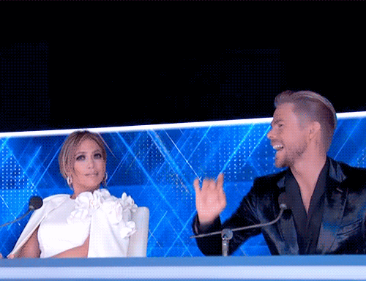
How Song Buddy works?
STEP 1
Input your song
STEP 3
STEP 2
Recommending you similar songs
Song buddy working behind the scene

Slide 12
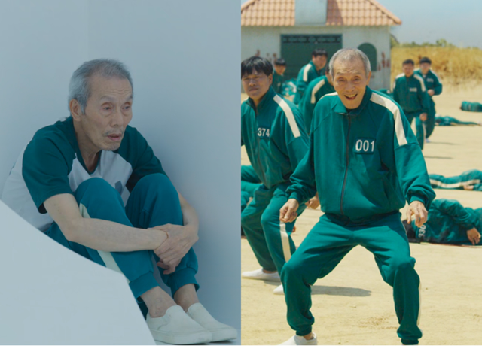
Me before discovering Song Buddy
Me after discovering Song Buddy

Slide 13


Slide 14


Slide 15


Slide 16


Slide 17

USE SONG BUDDY!
SEND YOUR BOREDOM AWAY!

